Slide 1

Data Nerds-Group #10
Milestone #1 Check-In

Slide 2

Bonds, Warranties, and Insurances required & Status:
Our Question?
How would the use of renewable energy affect construction sites in terms of cost , energy usage and carbon emissions within the middle east and African regions?
Commercial Status
Data Nerds- Group #10

Slide 3

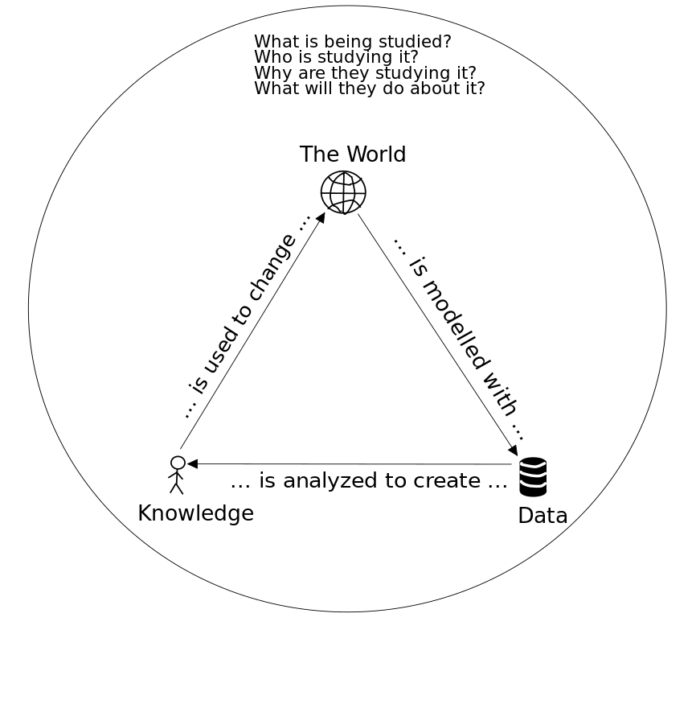

Research Brief

Slide 4

Strategy
The target is to collect data from construction professionals involved in project implementation.
Primary focus will be on electrical work equipment, building machines, drills, and energy consumption patterns.
Data will be collected across Ghana, Nigeria, and the UAE.
A structured template will be used to maintain consistency
Google Form to be used as the primary data collection tool

Slide 5

Actions from Previous Meetings
Ref | Subject
1 | Create a Google Form for data collection
2 | Finalize survey questions
3 | Draft project timeline
4 | Add Questions to the Google Doc
6 | Begin initial data collection with the engineers
7 | Verify sufficiency of current data

Slide 6

Risk Mitigation
Risk
Mitigation Plan
Backup Data Collection Plan, it was proposed to obtain energy consumption data directly from construction companies. • Focus areas for backup collection: • Lighting energy usage • Broader equipment usage surveys
In case of limited form responses
Apply the concept of synthetic data

